Slide 1
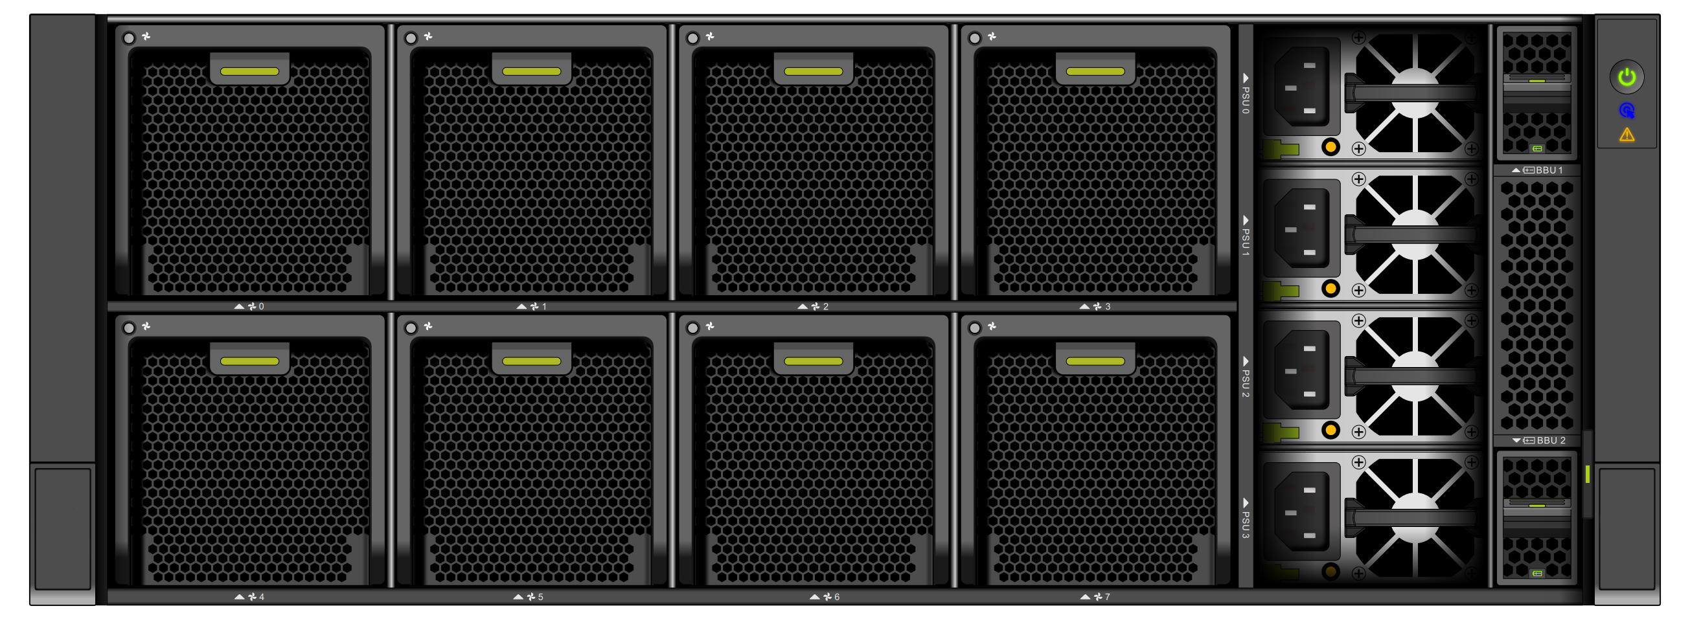
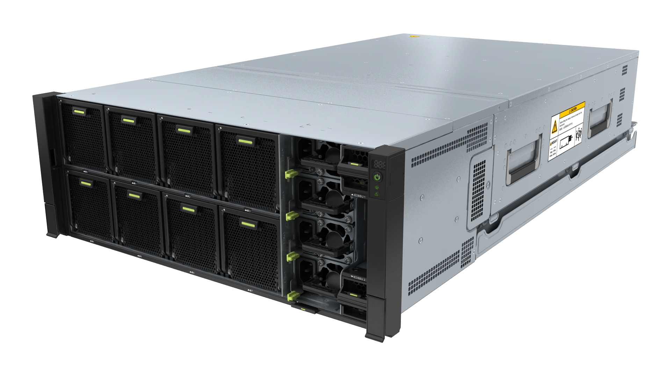
Openstor 2910
Technical Presentation

Slide 2
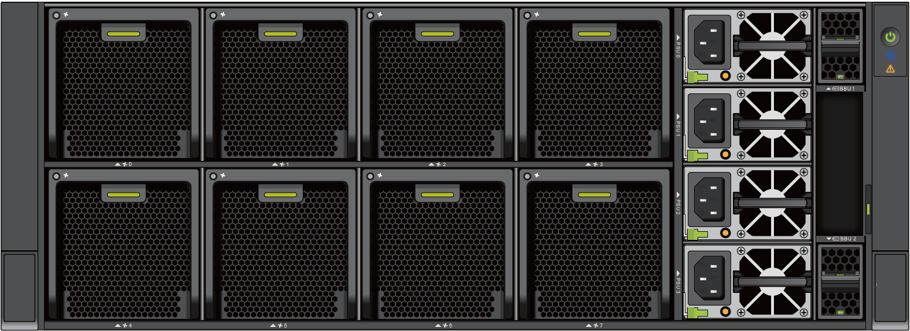

Key Competitiveness: Easy to Use
For SMEs, branches, and edges
Cloud O&M
⑤
⑤
Applications
④
Multi-site management on DME
③
④
Compute: virtualization and container
Unified management
Integration of storage, compute, and network resources in 4 U space
Software
All-in-one device
②
Enterprise-level storage capabilities: dual-controller and multi-protocol
RESTful API
Installation &
deployment
Monitoring management
Integrated
Simplified
Intelligent O&M
Edge-cloud synergy*
Integration of storage, compute, and network resources in 4 U space
Integrated storage + application platform
Ready-to-use and plug-and-play
Simplified connection, requiring no professional O&M personnel
Hardware
3 compute nodes and 2 storage nodes
①
Mobile phone
PC client

Slide 3
OpenStor 2910 Product Capabilities
Compute node | Number of nodes | 2 to 3
 | CPU | 1P/2P: C4310, C4314, C4316, C5318Y, C6330, C6346, and C6348
 | Memory | 16 GB/32 GB/64 GB x 16 (1P)/32 (2P)
 | Flex I/O card | Flex I/O card (OCP): I350 2-port GE card; CX4 2-port 10GE card
 | Standard PCIe card | CX4-2 port 10/25GE X550-2 port 10GE I350-2 port GE
 | AI card | T4, Atlas300I PRO
 | Disk | SAN Boot, without system disks
 | Onboard port | 2 x 10GE + 2 x 10GE
Storage node | Storage controller | Two controllers
 | CPU | 28-core 2.6 GHz per controller
 | Memory | 40 GB per controller
 | Onboard port | 2 x 10GE (used as the storage replication port)
 | Internal port | 2 x 25GE + 16 x 10GE
 | Disk in a controller enclosure | 4 SSDs + 6 HDDs
 | Disk enclosure for capacity expansion | 4 U 3.5-inch disk enclosure x 4, or 2 U 2.5-inch disk enclosure x 4
Compute node | Software suite | FusionCompute standard or advanced edition
 | Basic capability | Storage passthrough (eVol), VM template, thin provisioning, VM QoS, memory overcommitment, and dynamic resource scheduler (DRS)
 | Reliability | VM HA
 | Security | VM snapshot and clone
 | DR and backup | DR (being planned) and backup (being planned)
 | Network | Distributed virtual switch
 | GPU capability | GPU virtualization and passthrough
Storage node | Software suite | OceanStor OS basic, advanced, and optional packages
 | Basic service | iSCSI, CIFS, and NFS
 | Software for improved efficiency | SmartAcceleration, SmartQoS, SmartVirtualization, and SmartMigration
 | Software for data protection | HyperSnap, HyperClone, and HyperVault
 | Software for DR | HyperReplication, HyperMetro, and quorum server software
Local management | Site deployment | One-click initialization wizard
 | O&M | Automatic inspection, one-click capacity expansion, and one-stop upgrade
 | Monitoring | Device management, resource management, and performance statistics
 | Security | Security certificate, sandbox protection, and rights-based management
Central management | Software suite | DME Data
 | Management capability | Centralized alarm monitoring, VM management, storage resource management, and VM template provisioning
Hardware Capabilities
Software Capabilities

Slide 4
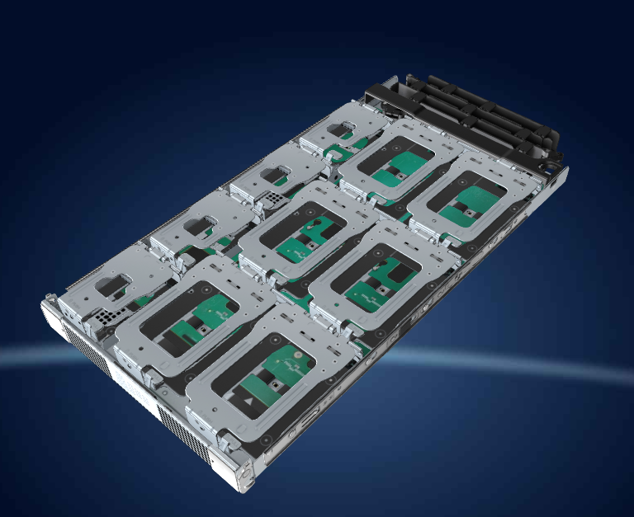
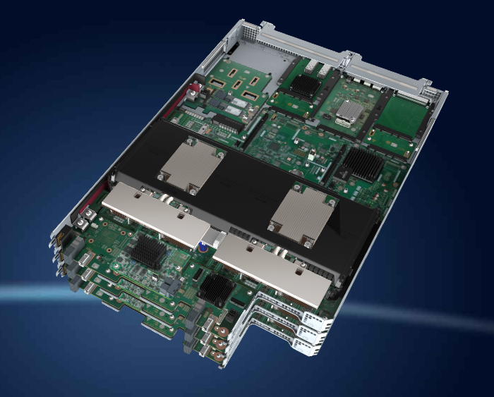
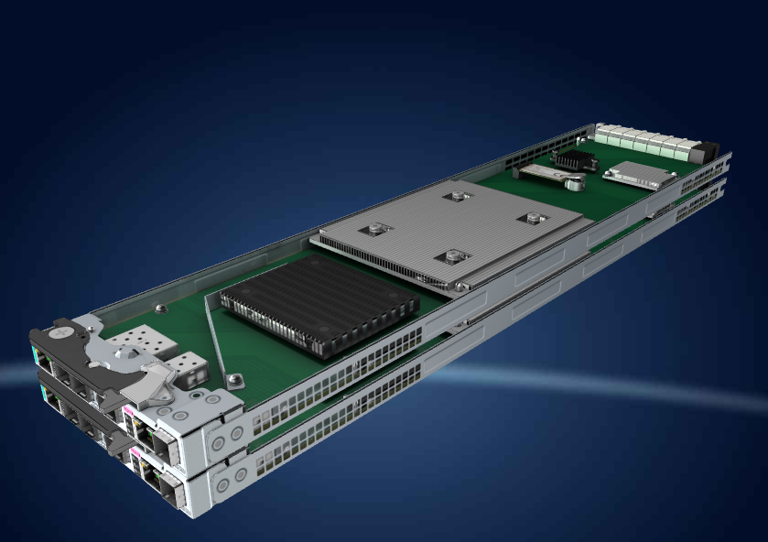
Hardware Architecture
Software Architecture
Network Architecture
Key Hardware Components
Onboard disk enclosure
Compute node (standard x86 mainboard)
Storage node (three-in-one control board)

Slide 5
Hardware Architecture
Software Architecture
Network Architecture
The System Automatically Divides Multiple Network Planes
MCNA
MCNA
Management plane: management network plane of the system. It is used for service operations and O&M management of the system.
Storage network: The 10GE direct network is used for SAN Boot and block services.
Switching network: network plane for customer service communication. It supports the TCP/IP protocol and 10GE networking. It shares the same network with the management plane and is isolated by VLANs.
BMC plane: server management IP plane. It uses the GE network and is used for O&M management of server hardware devices.
MetaVision
VRM
User VM
...
MetaVision
VRM
User VM
...
vSwitch
vSwitch
iBMC
iBMC
BMC plane
Management plane
Switching network
Storage network
Mirror channel
iBMC
Storage A
Storage B
iBMC

Slide 6
Hardware Architecture
Software Architecture
Network Architecture
Complex Networks Are Hidden Inside the System, Simplifying User Networks
Performance
96 Gbit/s physical bandwidth (max. software bandwidth: 40 Gbit/s)
Independent SAN and NAS networks
Onboard 3 x 10GE
Security
VLAN isolation
Independent management and service network ports
Reliability
Dual-plane symmetrical networking
Automatic network switchover in case of a port fault
Compute network
Switchable between BOND1 and BOND4
Storage network
Active-active NAS/SAN networks
Ease-to-use
Switch-free configuration
Access to any compute or storage node through one service line
Access to any compute or storage node through one management line
Compute node 0
Compute node 1
Compute node 2
BMC
1822
BMC
1822
BMC
1822
1
2
3
4
1
2
3
4
1
2
3
4
bond1
bond1
bond1
CTE0.A.I1
eth-hns1
CTE0.A.I2
eth-hns5
CTE0.A.I3
eth-hns7
CTE0.B.I1
CTE0.B.I2
CTE0.B.I3
SW
Switch module
CTE0.A.I7 eth-hns4
bond4
CTE0.B.I7
Switch module
SW
BMC
CTE0.A.I8 eth-hns6
CTE0.B.I8
BMC
CTE0.A.I10
eth-hns11
CTE0.A.I9 eth-hns10
CTE0.B.I9
CTE0.B.I10
mgmt
CTE0.A.I5
eth-hns13
mgmt
CTE0.A.P0
eth-hns14
CTE0.A.P1
eth-hns12
CTE0.B.I5
CTE0.B.P0
CTE0.B.P1
CTE0.A.I0
eth-hns3
CTE0.A.I4
eth-hns9
CTE0.A.I6
eth-hns15
CTE0.B.I0
CTE0.A.MGMT
eth-hns3.2910
CTE0.B.I4
CTE0.B.I6
CTE0.B.MGMT
Storage A
eth-hns0
Storage B
Controller A
eth-hns2
Controller B
bond1/4
CTE0.A.P2
eth-hns8
CTE0.B.P2
bond1/4
10GE, internal switching network
10GE, iSCSI and diskless boot network
10GE, connected to the external network
Panel port
GE, management network
25GE, storage management network + service network
10GE, storage mirroring network

Slide 7
III. Key Features of OpenStor 2910

Slide 8



Simplified Management: In-depth Integration Reduces Deployment Duration by 75%
Easy-to-Use
High Efficiency
Security and Reliability
Pre-installation before delivery, and one-click installation and deployment, enabling quick rollout of new services
Resource management
Maintenance
Monitoring
6 hours
Hardware
resource
Virtualization cluster
Unified upgrade
Unified monitoring
Physical device monitoring
VM status monitoring
75%
1.5 hours
One-click inspection
One-click capacity expansion
Performance monitoring
Storage cluster
Unified management platform
for one-stop management
Openstor 2910 DeviceManager
Free from network planning
Free from system installation
Free from storage configuration
Free from documentation learning
No specialized tools required
Compute
Storage
Network switching
VM

Slide 9




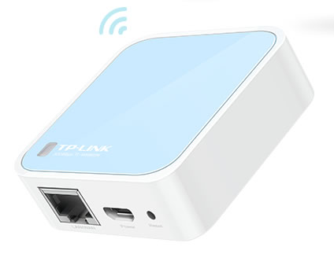
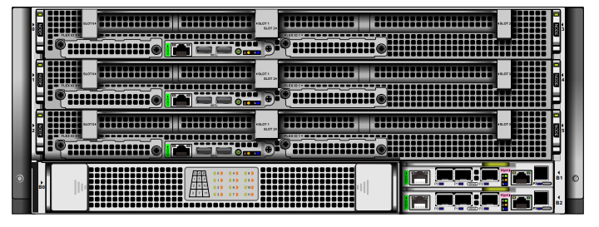
Easy-to-Use
High Efficiency
Security and Reliability
Simplified Site Deployment by Scanning QR Codes with Mobile Phone, Requiring No Professional Skills
eService
Configuring on the cloud
Site deployment by scanning QR codes with mobile phones
Internet-free device access
Device management IP addresses
Licenses
Others...
Automatic configuration download
Automatic license import
Automatic quality inspection report obtaining
Automatic archive creation on eService
Simplified connection
Portable small box, facilitating plug-and-play
Internet-free access, eliminating customers' concerns

Slide 10
Easy-to-Use
High Efficiency
Security and Reliability
Simplified Hardware: No System Disks on Compute Nodes, Implementing Plug-and-Play of Compute Nodes
Economic and efficient
Costs of server system disks and RAID controller cards are spared.
The deduplication and compression features of the storage system can effectively reduce the space occupied by system disks.
System disk space waste is avoided.
High reliability
There are no system recovery difficulties caused by RAID controller card and system disk faults.
Dedicated SAN BOOT multi-path direct-connection network prevents the impact of external network and single-link faults.
Stateless computing
The OS is decoupled from server hardware, and server nodes can be replaced randomly.
Quick recovery
Inherent advantages of enterprise storage are leveraged to protect OS data.
More innovations
Quick host recovery: The lossless snapshot mechanism of the storage system can be used to quickly recover the host OS if the host OS breaks down unexpectedly due to environment or software errors.
In the future, the entire device will support the evergreen feature, avoiding complex system installation and configuration.
VM
UVP
Driver
OS
LUN
LUN
LUN
POOL
SSD
SSD
SSD
SSD

Slide 11



Easy-to-Use
High Efficiency
Security and Reliability
Converged SAN and NAS: One System for Multiple Workloads, Improving Efficiency
  Parallel SAN and NAS
Healthcare
HIS/PACS
  iSCSI/FC
  NFS/CIFS
Block service
File service
Finance
RAID 2.0+
Storage pool
Gateway-free
Integrated block and file storage and NAS gateway-free design for 20% lower procurement costs
Parallel architecture
The system provides optimal paths for concurrent access of SAN and NAS to maximize performance.
Government
E-Gov./OA systems

Slide 12
Easy-to-Use
High Efficiency
Security and Reliability
Distributed Active-Active Architecture for LUNs and File Systems, Implementing Global Resource Sharing and Load Balancing
SAN/NAS client access protocol
The new-gen OceanStor hybrid flash storage, integrated into the OpenStor 2910 solution, uses a distributed active-active architecture:
LUNs/File systems do not belong to any controller. I/O reads from or writes to LUNs are processed by multiple controllers concurrently. Directories of file systems are distributed to all controllers for parallel processing.
Write I/Os are written to the global cache. Read I/Os are hit in the global cache. Cache flushing and prefetch are evenly processed by controllers.
A global pool is created at the back end. LUN space is evenly distributed to the resource pool across controller enclosures, implementing back-end disk space sharing.
LUN/File system I/O requests
Global cache
DHT
Controller A
Controller B
Controller C
Controller D
LUNs/File systems do not belong to any controller.
LUN/File system

Slide 13
Easy-to-Use
High Efficiency
Security and Reliability
Hot Data Is Changeable. How Can We Effectively Use SSDs to Improve Performance?
Hot data scenarios
Data exchange platform
Virtualization
Check images
1
Stable read hot data
2
Stable write hot data
①②③④⑤
①③②④⑤⑥
⑦⑧
Read performance acceleration
Write performance acceleration
LBA
Logical address-related
Stable hot data
Tier
Tier/Cache
3
Read: alternate change of hot and cold data
4
Write: alternate change of hot and cold data
Changeable hot data
Cache
Strongly dependent on algorithm capabilities
Tier
(ROW append write technology)
Time-related:
There is a higher probability that most recently modified data is read-after-write hot data.
5
6
Overwrite on non-hot data
Changeable hot data in lifecycle
Tier
Tier
(Optimized automatic configuration)
7
Time decay-related read hot data
Time decay-related
Read-after-write hot data
Tier
(ROW append write technology)
Tier
(ROW append write technology)
8
Time decay-related write hot data
Tier+cache technology relies on the ROW append write technology and effectively improves hybrid storage performance.
New
Time
Old

Slide 14


Easy-to-Use
High Efficiency
Security and Reliability
SmartAcceleration: Innovative Data Layout Algorithm Accelerates Access to All Hot Data and Delivers Flash-like Experience
ROW-based large-block sequential writes
SmartAcceleration
Eight data acceleration scenarios
Global data write optimization
Reading hot data from fixed addresses
Reading hot data from unfixed addresses
Writing hot data to fixed addresses
Writing hot data to unfixed addresses
Reading hot data after write
Overwriting non-hot data
Reading hot data with access frequency decaying over time
Writing hot data with access frequency decaying over time
100% better performance
Flexible convergence of heterogeneous media
Cache
Tier
SmartCache
Optimal cost-performance balance
SmartTier (Write in Place)
Global cold and hot data perception
SmartTier (ROW)
Multidimensional feature learning of neural networks

Slide 15
Easy-to-Use
High Efficiency
Security and Reliability
SmartAcceleration: ROW-based Large-Block Sequential Writes Solve Random Write Performance Bottlenecks of HDDs
Next-gen OceanStor hybrid flash storage, integrated into the OpenStor 2910 solution, row-based large-block sequential writes
Data to be modified
B'
D'
E'
Snapshot
S
Snapshot
S
The latest data
N
Data written
A
B
C
D
E
P1
P2
Data written
A
B
C
D
E
P1
P2
Traditional solution (OceanStor V5)
Write in Place
S
N
New data
B'
D'
E'
X1
X2
P1'
P2'
Snapshot
The latest data
Data after modification
Small I/Os are aggregated into large I/Os for sequential writes, eliminating HDD bottlenecks.
New data forms a new RAID group and no write penalty is generated.
The original data does not need to be migrated and no overhead is generated.
A
B'
C
D'
E'
P1'
P2'
Snapshot
protection zone
The write performance is poor when the data to be written is not at the SSD layer.
Write penalty is generated due to overwriting.
Overheads are generated when original data is migrated to protected zones.
B
D
E
Resolve all write performance issues of hot data.

Slide 16
Easy-to-Use
High Efficiency
Security and Reliability
SmartAcceleration: Elastic Tier/Cache Convergence for Optimal Cost-Performance Balance
Traditional hybrid flash storage
Tier/Cache space isolated
New-gen OceanStor hybrid flash storage
Elastic tier/cache converged
SSD cache
Performance layer
SSD cache/tier
Data migration based on access frequency
Disadvantages
The SSD performance layer is exclusively used and cannot be shared across pools.
Caches and tiers are independent, and physical space usage is inefficient.
Data needs to be frequently migrated based on access frequency, affecting performance.
Regular migration
SSD tier
SSD tier
NL-SAS tier
NL-SAS tier
SAS tier
SAS tier
Advantages
Caches and tiers converge into a performance layer, enabling efficient cross-pool sharing.
The cache-to-tier capacity ratio is automatically configured by the system, achieving optimal efficiency.
Data does not need to be migrated across caches or tiers, reducing the impact on performance.
NL-SAS tier
NL-SAS tier
Pool 1
Pool 2

Slide 17

Easy-to-Use
High Efficiency
Security and Reliability
SmartAcceleration: Adaptive Access Frequency Perception and Prediction Algorithm, Effectively Improving Hot Data Hits
1 MB
Performance layer
Multi-granularity hot data statistics
Hot data information always occupies 20 bytes of memory.
High hot data granularity would waste memory space, while low hot data granularity would waste capacity space.
Multi-granularity statistics balance accuracy and efficiency.
Hot data prediction based on time sequence
Insufficient response to periodic changes in hot data when judging hot data based on historical access frequency.
Predicts future hot data based on machine learning algorithms, achieving higher accuracy of hot data hits.
8 KB
64 KB
Algorithm: predicts
hot data
Advanced prefetch
64 KB
32 KB
8 KB
Cold
Hot
1 MB
Time
T0
Current
T1
Prefetch based on continuous addresses
Multidimensional associated data prefetch
Associations between data may be related to logical addresses and time.
Prefetch based on continuous addresses has a low hit rate.
Self-learning of multidimensional correlations
Prefetching based on associations has a high hit rate.
Massive small files
Elimination policies of scenario-based access frequency info.
Small I/Os/Large files (in a tree) and small files (in a queue) differ in the structure of access frequency info., and cannot be combined.
When the memory space is insufficient, some info. needs to be eliminated.
The elimination priority is adjusted based on the I/O scenario.
Performance is greatly improved in hybrid workload scenarios.
Small I/O access frequency info.
eliminated in priority
HBA address
Prefetch based on associated addresses
Memory
space
...
...
Small I/O
access frequency info.
HBA address
Small file
access frequency info.
Prefetch based on associated times
...
...
...
...
Timeline
T0
T1
T2
T3
T4
Small file access frequency info.
eliminated in priority
SAN/Large files

Slide 18

Easy-to-Use
High Efficiency
Security and Reliability
SmartAcceleration: Dynamic, Adaptive Data Layout Policy
Write
Read
DRAM
DRAM
1. Find hot read data in the DRAM.
Intelligent access frequency identification algorithm
Intelligent access frequency identification algorithm
Small I/Os are written into the SSD tier;
Hot read data is overwritten to the SSD tier.
Write I/O distribution
Admission: Check whether the data is hot enough to be distributed to SSDs.
Miss
Admission
SSD performance layer
Cache
Miss
Tier
SSD performance layer
Cache
Tier
2. Find hot read data in the SSD cache.
3. Find hot read data in the SSD tier.
Elimination
Regular migration
Aggregated large I/Os delivered to disks
Miss
Read
(including prefetch)
Hot data I/O
HDD capacity layer
HDD capacity layer

Slide 19
Easy-to-Use
High Efficiency
Security and Reliability
Performance with value-added features enabled
Competitor hybrid flash storage: 20% to 30% decrease; Huawei OceanStor hybrid flash storage: <10% decrease
ROW Architecture
Uncompromised Performance (Value-Added Features Enabled)
Initial performance
GC
RAID 6
Snapshot
Competitor hybrid flash storage
Huawei OceanStor hybrid flash storage
Test equipment: dual-controller, 1 TB cache, 48 NL-SAS HDDs + 4 SSDs

Slide 20
Easy-to-Use
High Efficiency
Security and Reliability
Performance comparison in typical configurations
48 NL-SAS HDDs + 4 SSDs
OceanStor V5
New-gen OceanStor
hybrid flash storage
180%
110%
100%
Performance Improvement Over OceanStor V5
230%
8 KB small I/O
Reads/Writes: 7:3
64 KB small file
Reads/Writes: 6:4
2 GB large file;
8 KB small I/O
Reads/Writes: 7:3
*Test results from Huawei Lab

Slide 21
SmartCompression: High Performance and High Reduction Ratio Delivered by Compression + Compaction + Rearrangement
Compression logic optimization
Byte-level compaction
DIF rearrangement
Compression Ratios of Mainstream Algorithms
8 KB data blocks
Data
X
Data
...
Original data structure
X
Data
X
Data compression
Identifies and rearranges the data integrity field (DIF) values X to ensure data continuity and improve compression efficiency.
B1
B2
B3
B4
B5
Write 4 MB data using the 1 KB alignment and compaction technology.
Structure after rearrangement
Data
Data
Data
...
1 KB
3 KB
5 KB
7 KB
9 KB
10 KB
X
X
X
Benchmarks: Linux Mint Debian edition server (Linux version 4.8.0-1-amd64), with a Core i7-6700K CPU @ 4.0 GHz, using lzbench.
Space wasted by supplementary
Data is aligned by 1 KB and the space wasted by supplementary is not compressed.
Compresses the DIF values.
LZ4: fast compression
B1
B2
B3
B4
B5
Structure after compression
...
Data
Data
Data
New X
Upgraded to
Upgraded to
1 KB
3 KB
5 KB
6 KB
Zstd (high compression ratio)
Byte-level alignment achieves space waste of less than 1%.

Slide 22
Easy-to-Use
High Efficiency
Security and Reliability
HyperLock/WORM: Complies with Industry Regulations to Ensure the Security and Legality of Data Archiving
WORM
Write Once Read Many (WORM) is a data protection technology that allows data to be written only once.
Protected files cannot be modified or deleted after being written.
Enterprise WORM* and Compliance WORM can be selected as required.
Compliance WORM protects data in compliance with SEC Rule 16a-4(f), allowing enterprises to avoid legal risks in confidential file archiving.
The maximum protection period is 30 years. Files can be automatically locked after being written and deleted when the protection period expires.
It is compatible with mainstream NAS backup and archiving software
Clock tampering prevention
Enterprise mode*
More rights for administrators
Compliance mode
SEC Rule 16a-4(f) compliance
30 years
Max. protection period
Automatic locking and deletion upon expiration
Clock tampering prevention
Initial state
Locked state
Appending state
Expired state
WORM state transition (OceanStor hybrid flash storage)

Slide 23



Easy-to-Use
High Efficiency
Security and Reliability
Secure Snapshot: Protects Important Data Backups from Accidental or Intentional Deletion
Interval: 3 seconds for LUNs; 15 seconds for file systems
LUN/File system
TP
TP+1
TP+2
...
TP+N
HyperCDP object
CDP 0
CDP 1
CDP 2
...
CDP N
Create a secure snapshot.
Max. = 60,000 for LUNs
Max. = 4,096 for file systems
Rollback
In financial scenarios, read-only snapshots are configured for important data and converted into secure snapshots to prevent backups from being deleted accidentally or intentionally. This meets the requirements for long-term secure storage of important data. A retention period can be set for a secure snapshot. The snapshot cannot be deleted within the retention period. After the period expires, it can be deleted manually or automatically.
Secure snapshot:
Either a single secure snapshot or a secure snapshot consistency group (CG) can be created.
HyperCDP objects can be converted into secure snapshots, and HyperCDP CGs can be converted into secure snapshot CGs.
A secure snapshot cannot be deleted before it expires.
The expiration time of a secure snapshot can be extended.
Security snapshots can be automatically deleted after they expire.
Fast recovery:
In the event of a disaster, a non-infected snapshot in the production center is used for recovery.
Minimum recovery granularity: 3 seconds for LUNs and 15 seconds for file systems
Serial port mode:
The security administrator can shorten the protection period of secure snapshots.
The security administrator can delete secure snapshots that have not expired.
The security administrator can change a secure snapshot to a common snapshot.

Slide 24




Easy-to-Use
High Efficiency
Security and Reliability
NAS Antivirus: Provides Two Virus Scanning Modes and Is Compatible with Multiple Mainstream Antivirus Software
OceanStor storage
SMB
file access
Antivirus server
NAS antivirus scans storage systems for files infected by viruses.
Support on-demand and on-access scanning modes and provide virus scanning service on demand.
Support both ShareOpen and ICAP interaction protocols.
Support a maximum of 64 antivirus servers at the same time, improving the throughput.
Compatible with mainstream enterprise-level antivirus software such as Symantec Endpoint, Trend Micro, McAfee, Sophos, and Kaspersky.
Storage
console
DeviceManager
/CLI
NAS file system
Trigger virus scanning and removal.
Antivirus engine
SMB
ShareOpen/
ICAP
On-access
scanning
On-demand
scanning
Antivirus agent
Virus-infected files
Antivirus function
Antivirus monitoring
Return the scanning and removal result.
TCP/IP
Front-end host
Antivirus server

Slide 25
IV. Open Platform

Slide 26
Stability and Reliability
High Efficiency
Security and Trustworthiness
High Compute Performance and NUMA Topology Optimization
Default scenario
NUMA enabled
No NUMA
NUMA scheduling optimization
No policy control, slow cross-node memory access
A CPU preferentially uses the memory on the same node to reduce memory access latency, improve access efficiency, and improve application performance.
VM1
VM1
MEM
MEM
CPU1
CPU2
CPU1
CPU2
HOST
Slow
HOST
Fast
Fast
NUMA Node1
NUMA Node2
NUMA Node1
NUMA Node2
MEM
MEM
MEM
MEM
CPU1
CPU2
CPU3
CPU4
CPU1
CPU2
CPU3
CPU4
VM compute performance improved by 15% to 30%
Scenario: Applies to multi-core services requiring high memory access, ensuring optimal VM memory access performance.

Slide 27
Stability and Reliability
High Efficiency
Security and Trustworthiness
Huge Page Memory Access Acceleration and Precise QoS Assurance for Compute Performance
Huge page memory optimization
Compute resource QoS
Traditional 4 KB page table:
A large number of memory page tables exist. The number of page tables cached by the TLB is limited, causing a high miss rate.
VM
...
Note: This applies to memory overcommitment scenarios.
High-speed
cache
TLB
Address translation
Memory access
Miss
4k
...
CPU quota
Multiple VMs
compete for the CPU resources based on the CPU quota.
Memory quota
Multiple VMs
compete for the memory resources based on the memory quota.
Low speed and multiple times
1 GB huge page:
A few number of memory page tables exist. CPUs access TLB cache page tables directly with a high hit rate.
High-speed
cache
TLB
CPU reservation
The minimum CPU computing power
available to VMs is precisely controlled.
Memory reservation
The minimum memory capacity
available to VMs is precisely controlled.
Direct
access
Cache page table
1G
Address translation
Memory access
  30% higher performance for large-memory applications
    Scenario: Applies to large-memory services, such as Oracle databases.
  Fine-grained resource allocation, ensuring VM compute performance
    Scenario: Resources are reused to the maximum extent to reduce costs when resources are limited.

Slide 28
Stability and Reliability
High Efficiency
Security and Trustworthiness
OVS + DPDK, improving network forwarding performance by 6 times
Kernel-mode OVS
SR-IOV passthrough
User-mode OVS + DPDK
VM 1
VM
VM 0
vNic
vNic
NIC driver
vNic1
vNic2
NIC driver
Virtualization layer
FusionCompute
Virtualization layer
Virtual switch
User mode
Virtual switch
DPDK
EVS process
Data
channel
Flow table
VF
VF
VF
...
VF
Kernel mode
No kernel-mode forwarding processing is required.
Physical NIC
Physical NIC
(Intel 82599ES, Intel XXV710, and Intel XL710)
Physical NIC
The OVS technology is used to provide advanced network features such as IP-MAC binding and security groups, implementing fine-grained network QoS control.
The hardware virtualization capability provided by physical NICs is used to mount virtual hardware devices to VMs. The network I/O performance and latency of VMs are close to those of physical NICs.
The Data Plane Development Kit (DPDK) technology is used to accelerate network forwarding, and huge pages and user mode are used to reduce packet copies, improving network forwarding efficiency by a maximum of six times and greatly improving pulse per second (PPS).

Slide 29




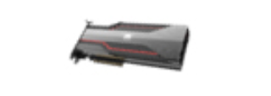
Stability and Reliability
High Efficiency
Security and Trustworthiness
GPU Graphics Acceleration and Atlas-enabled AI Training
GPU acceleration
Host
Host
AI acceleration
Host
VM
VM
VM
VM
GPU driver
GPU driver
GPU driver
Altas driver
vGPU
vGPU
GPU passthrough
Atlas 300 AI accelerator card
GPU virtualization
GPU passthrough and GPU virtualization are supported, improving user experience of high-performance graphics and image applications.
Huawei Ascend Altas 300 AI acceleration is supported, which provides AI processors with the optimal energy efficiency ratio.
Scenarios: engineering drawing, media production, 3D games, GIS, and graphics and video processing
Scenarios: AI inference and training services
Models that support GPU virtualization and passthrough: NVIDIA P4, P40, M60, and V100 GPU; models that support GPU passthrough only: NVIDIA P100 and Atlas 300

Slide 30
Stability and Reliability
High Efficiency
Security and Trustworthiness
eVol Storage with Automatic Configuration and Storage Offloading, Improving Performance
eVol storage
Advantages
Virtual disk
vs.
Raw device mapping
vs.
eVol disk
Improved performance: Compared with the VIMS solution, the I/O passthrough VM improves the performance by 15%, meeting the requirements of high-performance scenarios in the industry.
Automatic configuration: A simplified storage management solution is provided for customers, reducing six steps for manual configuration and saving 80% manpower.
Storage offloading: The capabilities of value-added storage features in virtualization can be fully utilized.
Benchmarking with competitors: The VMware vVolume benchmarking features are supplemented.
NOF+ technical preparation: Provide basic storage management functions to prepare for the next step of exiting NOF+.
VM1
VM2
VM2
FusionCompute
Virtual disk
ISCSI/FC
RESTful
ISCSI/FC
VIMS
SAN storage device
LUN
LUN
LUN
LUN
LUN
Shortened storage device I/O path, ultimate performance, automatic end-to-end provisioning, and storage offloading
Scenarios: high I/O and low latency services such as cluster file systems, and video and image processing, automatic service provisioning, high performance of virtualization service operations; computational storage

Slide 31



Stability and Reliability
High Efficiency
Security and Trustworthiness
Comprehensive Protection, Full Control over Security
Network
Management and O&M
Host security
VM security
******
EulerOS
Network plane isolation
Separation of management, service, and storage planes
Account password management
Weak password restriction
Brute force attack prevention
Validity period control
Permission management
Rights separation
Rights- and domain-based management
Web security
Prevention against cross-site attacks
SQL injection prevention
Host hardening
Tailoring and hardening
System exception detection
Virtualization antivirus
Agentless antivirus
Agent-based antivirus
Security group
Inbound and outbound control
Multi-protocol precise control
Update
Transmission security
Automatic redirection to HTTPS
TLS encryption
Log management
Access with specific permissions
Modification and tampering forbidden
Operation traceability
Certification key
Custom replacement
Database hardening
Redundant command clearance
Periodic backup
Security patch
Security vulnerability patches are periodically provided on the official website.
Network security
Deep packet inspection (DPI)
Firewall
Data storage security
Data isolation
Secure data deletion
Platform security
VM security

Slide 32
V. Solution

Slide 33

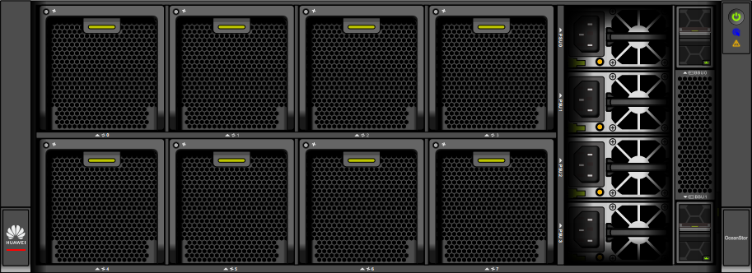





Branch Office Solution
Integrated management of storage, computing, and network devices
Device Manager:
single-node integrated management
Virtual Resource Management
branch
Site Management
branch
Alarm management
branch
Unified configuration
Partner tenant managed service
branch
eService:
cloud-based O&M
DME:
Unified management and O&M of central and branch offices
Performance statistics
Mobile app O&M

Slide 34
Integrated design for small- and medium-sized IC enterprises
Joint Solutions with FusionCompute Ecosystem
Physical, chemical, biological lab examination
Edge sites of central control stations
Internship and practice scenarios
Education
Electric power
Manufacturing
Core services of small- and medium-sized hospitals
Integration of district elementary education schools
Supermarket chain
Healthcare
Large enterprise
Enterprise document cloud
Smart campus management
Horizontal solutions
Application emergency takeover
Branch/Center
ISV application appliance

Slide 35
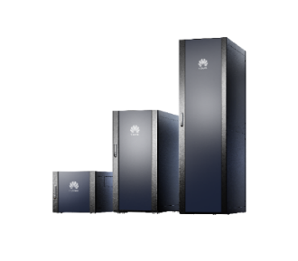
Planning: Cloud Application Store for Online and Offline Application Sharing, DME IQ for Remote Application Monitoring and Deployment
App store
(HIS cloud)
App client
App monitoring
App release/settlement
e+
Web
App
Remote app deployment
App release
App settlement
App push
App deployment
App monitoring
FCV application store (for customers): Local and cloud application stores can be configured, which allows applications to be pulled from the cloud to local devices.
eService application store (for ISV partners): deployed on a public network to establish an HCI application ecosystem. Applications that pass the compatibility certification can be released in the app store. In addition, authorized ISV partners can remotely deploy applications.
DME IQ (for customers): supports remote application monitoring and deployment.
e+ (for frontline/ISV partners): releases products to Smart Configuration Tool (SCT) and settles orders.
eService cloud application store:
Ecosystem building: ISV partners can upload and review applications, and bring applications online and offline.
Settlement: third-party software releasing on e+ and order placement from the SCT configurator
Application push: FCV can be interconnected with the cloud application store. Users can download available applications to the local repository.
Remote application deployment: allows ISVs to remotely deploy applications for customers who have purchased the remote application deployment service.
Remote application O&M: application running status monitoring, application monitoring indicator display, and periodic application update information push
Web client
Enterprise
Education
Healthcare
Database
Energy
Transportation
Others
Deployment
Monitoring
Quick deployment | O&M monitoring | One-click starting and stopping services
Server
App
App
App
App
App
App

